Slide 1

High G Flocculation
Roswell Lo, Mehrin Selimgir, Kanha Matai
Understanding and mitigating the effect of increasing headloss in the flocculator.
More at https://github.com/AguaClara/
High G Flocculation | Research | Final Presentation Spring 2018
Notes:
[[The High G flocculation team (High G Team) seeks to understand and mitigate the increase of pressure (also known as headloss) throughout experimental flocculators. First, The High G Team found that a buildup of coagulant- and not clay, is causing the pressure buildup in the flocculator for particle removal teams. This pressure buildup may be affecting the removal efficiency of the flocculator as particle removal experiments progress. The High G Team determined that using hydrophobic tubing is not an effective mean of reducing pressure buildup. Through various experiments the team found that pressure increase can be mitigated through creating a high shear force in the flocculator through sudden, short increases in water flow. The High G Team has determined a value which is the lowest amount of shear force necessary to mitigate pressure..]]
[[https://github.com/AguaClara/high_g_flocculation/blob/master/HighGFlocculation_Spring2018_ResearchReportFinalDraft.md]]

Slide 2
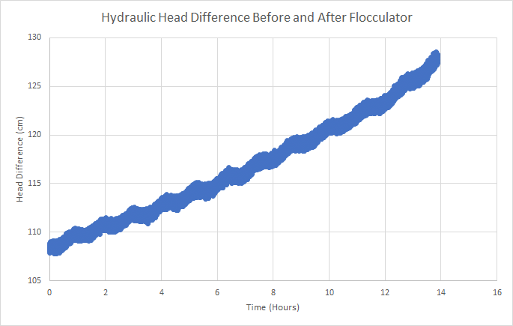
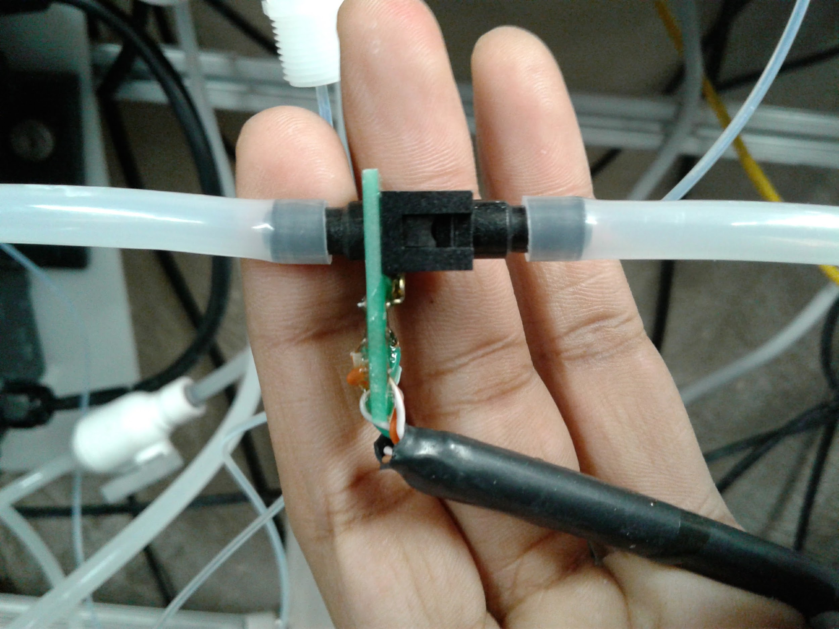
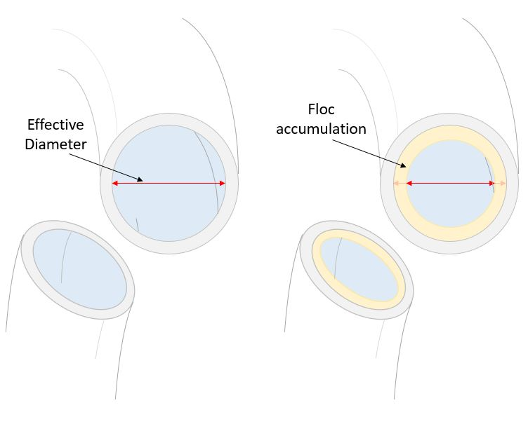
Background
Pressure Increased Throughout our experiments
High G Flocculation| Research | Symposiums Presentation Spring 2018
Notes:
We put a pressure sensor in our experiment to measure pressure difference in our experiment.
Higher pressure resulted in higher actual G, than our recorded ‘theoretical G’ based our pump speed.
Result was an increase of headloss from 108- 128 in 14 hours.
Image sources:
Sensor : https://www.overleaf.com/docs/11255738dpvxbmdstjqx/atts/66072875 from 2017 Fall High G flocculation
Graph : https://www.overleaf.com/docs/11255738dpvxbmdstjqx/atts/66202868 from 2017 Fall High G Flocculation
Accumulation schematic:

Slide 3
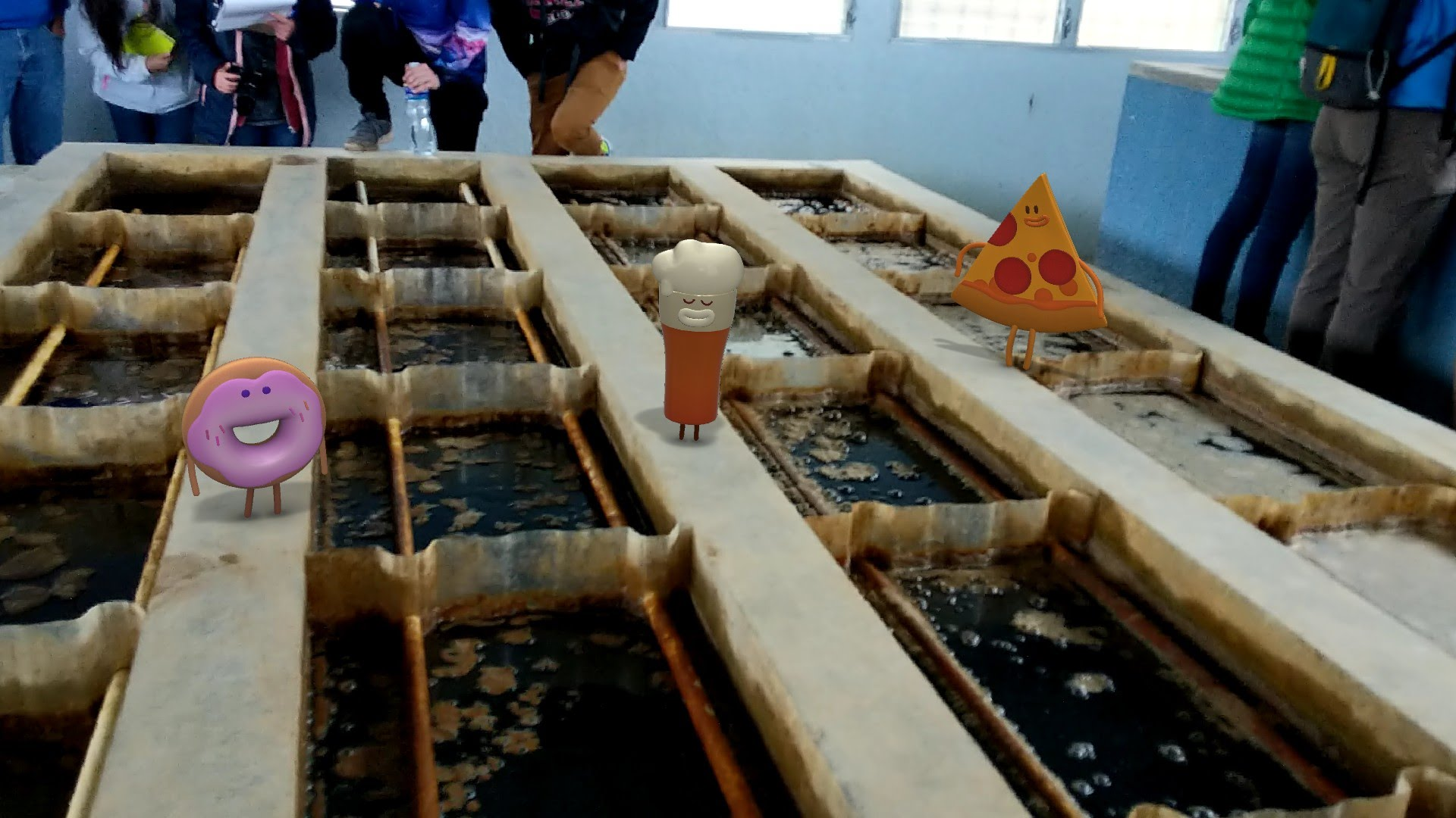
Background
Pressure increase in flocculator tubing is an issue that affects particle removal teams, although not actual AguaClara flocculators.
High G Flocculation | Research | Symposiums Presentation Spring 2018
Notes:
Due to the width/ volume of AguaClara flocculators, coagulant buildup on walls will not have any significant impact on actual AguaClara plants.
Caption your figure and explain its relevance to your presentation/thesis here. You can take the caption from your Final Report and modify it.
Write a summary of this slide here. A future team member or client should be able to read this note and understand this slide without having your team explain it to them.
If there are any appendix slides that are relevant to this slide, mention it in your notes.

Slide 4
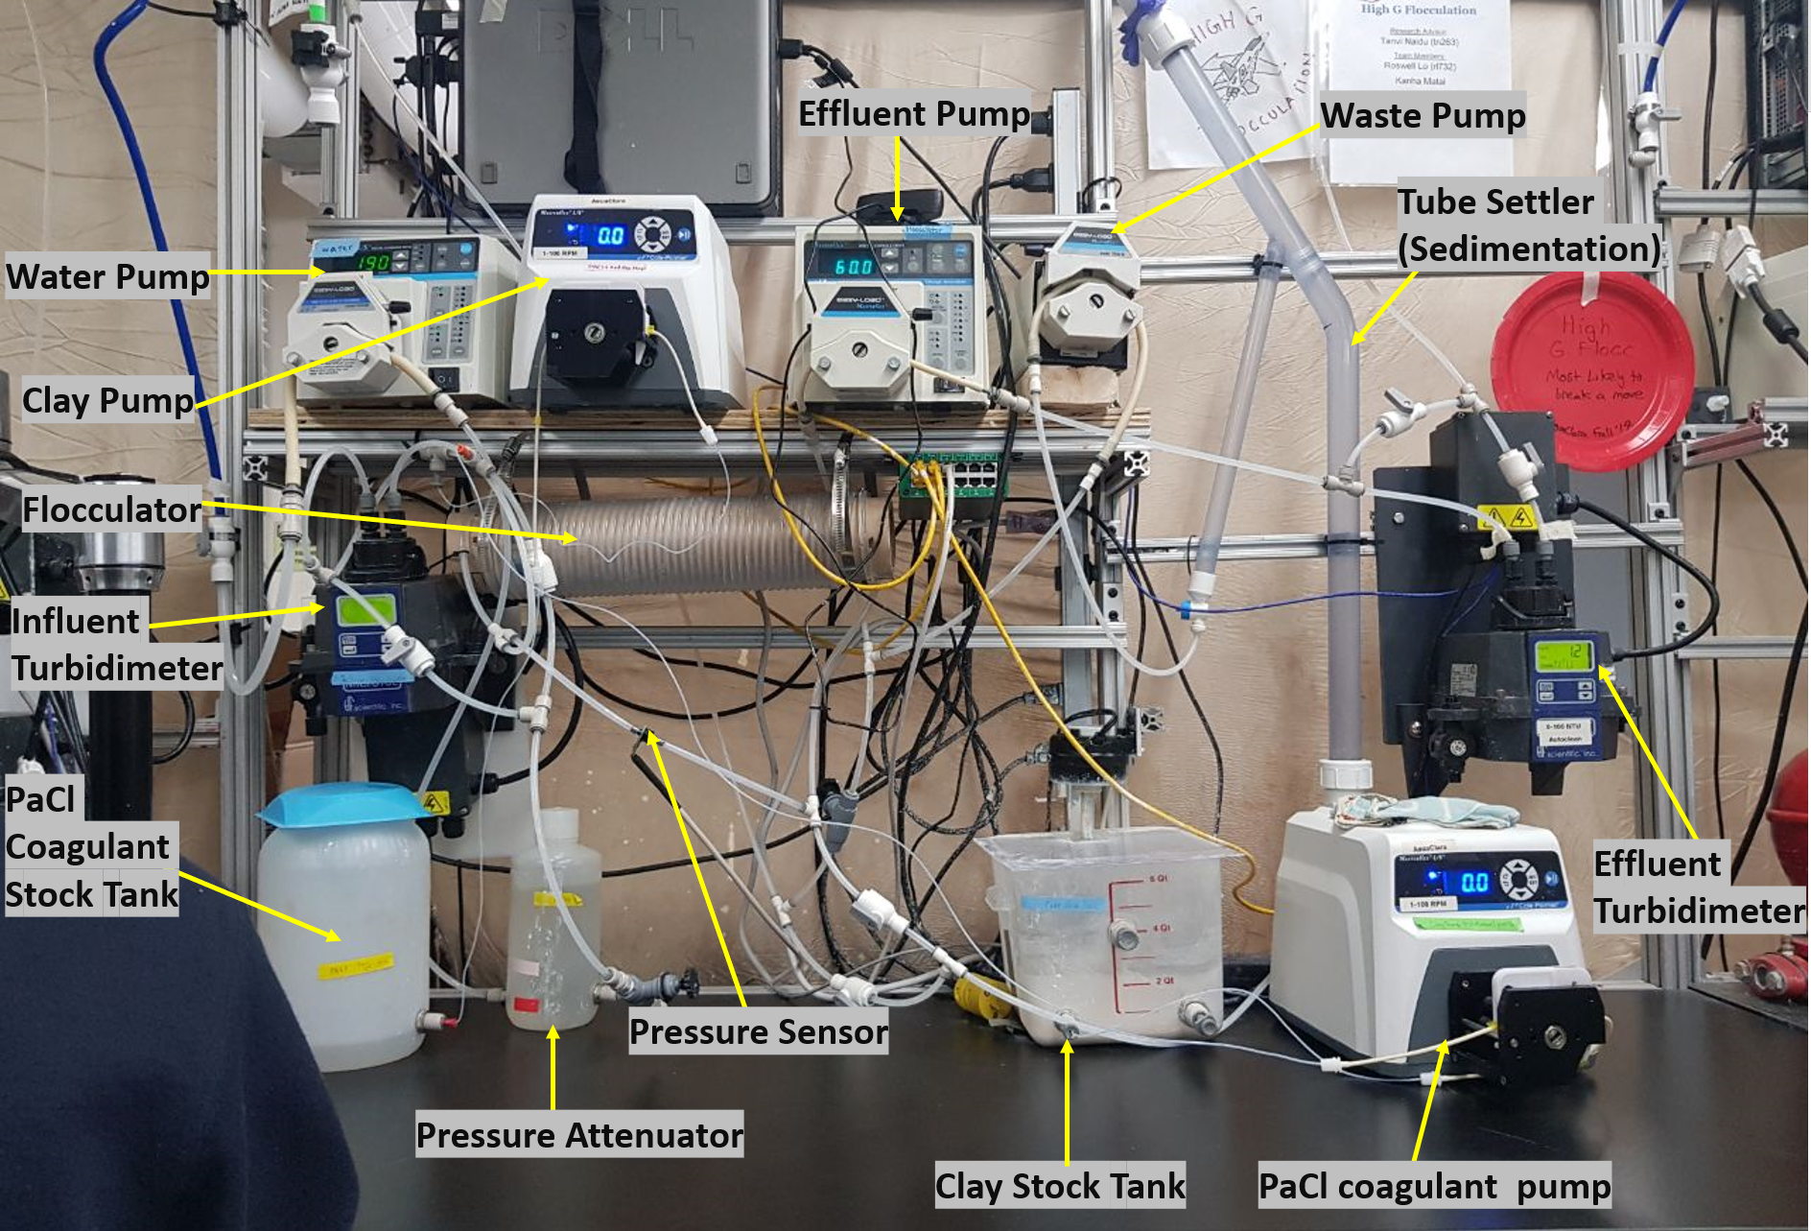
Experimental Setup
High G Flocculation | Research | Symposiums Presentation Spring 2018
Notes:
Image Source:https://github.com/AguaClara/high_g_flocculation/blob/master/HighGFlocculation_Spring2018_ResearchReport.md
High G Experimental Apparatus. An annotated photo of our experimental setup.
This setup takes a mixture of water, clay, and coagulant through a tube (hydrophobic & regular) flocculator, and has the clay settle as flocs in the tube settler. A total of five pumps are required in this setup.
The first of these is the water pump, which is used to vary the velocity of clay solution flowing through the flocculator, and therefore to vary G in a controlled manner.
The next two pumps are used to keep the concentrations of added clay and coagulant at a known and constant value.
The fourth is used to ensure that the upflow velocity within the tube settler is kept at 2 mm/s, as requested by the HRS subteam last semester. (See appendix 3)
The fifth and final pump is used to ensure that settled floc particles in the tube settler exits the system without clogging the tubes.
Measurements taken by the two turbidimeters will be used to determine the effectiveness of the different velocity gradients.
If there are any appendix slides that are relevant to this slide, mention it in your notes.

Slide 5
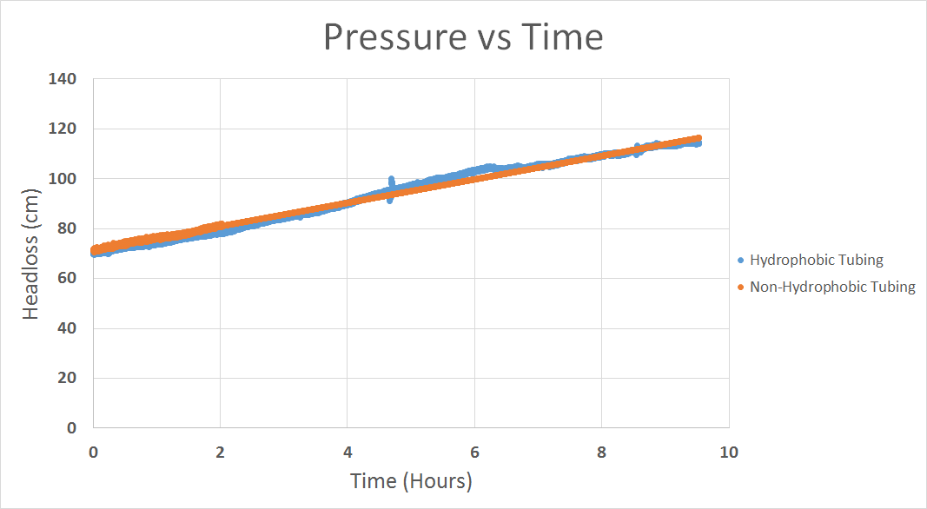
No Effect of Hydrophobic tubing on pressure build up
High G Flocculation | Research | Symposiums Presentation Spring 2018
Notes:
Image Source:https://github.com/AguaClara/high_g_flocculation/blob/master/HighGFlocculation_Spring2018_ResearchReport.md
Graph Comparing Hydrophobic and Regular Tubing.
When conducting the experiment comparing the headloss in identical experiments with solely changing the tubing from regular (non-hydrophobic) tubing to hydrophobic tubing, the trial yield achieved the following results.The results showed an insignificant difference in headloss reduction. In both experiments, the trial started at around 70cm and after 10 hours reached 120cm at a constant rate. This showed that the hydrophobic tubing was ineffective at minimizing headloss due to the coagulant.

Slide 6
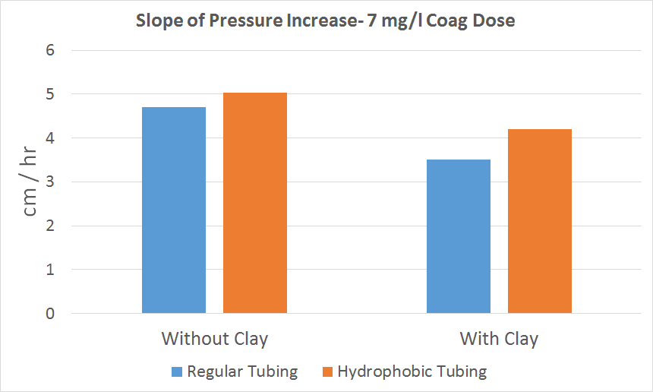
Coagulant is the main reason for increased pressure (Not Clay or Water)
High G Flocculation | Research | Symposiums Presentation Spring 2018
Notes:
Graph: Slope of Pressure Increase across 4 different experiments
Comparing hydrophobic and regular tubing experiments, we observed that the hydrophobic tubing experiments had higher pressure increases. Since we did not observe a significant benefit in using hydrophobic tubing (contrarily, we saw higher pressure increases) we determined that hydrophobic tubing was ineffective in mitigating pressure increase and continued our following experiments with regular tubing.
The chart above shows that experiments ran with clay and PACl had lower pressure increases compared to experiments with only PACl. This suggests that coagulant is the main contributor to pressure increase and that the presence of clay counteracts pressure increase by "using up" PACl.
If there are any appendix slides that are relevant to this slide, mention it in your notes.

Slide 7
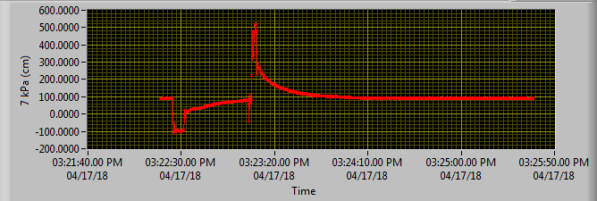
Pressure can be negated through increased flow from a syringe
High G Flocculation | Research | Symposiums Presentation Spring 2018
Notes:
Figure:ProCoDa reading of pressure sensor during a syringe press
From this image, it can be seen that as the syringe is being filled, the pressure drops below zero as flow is now in the opposite direction (the syringe is being filled before the flocculator so water from the pump is being pushed into the syringe and water from the flocculator is being drawn backwards into the syringe). Once filled, the pressure readings began to normalize. When ejecting the water from the syringe to the original, a substantial pressure difference was caused, reaching 500 cm of pressure. After reaching the peak pressure, the headloss through the flocculator slowly begins to stabilize back to its original headloss of 100cm.

Slide 8
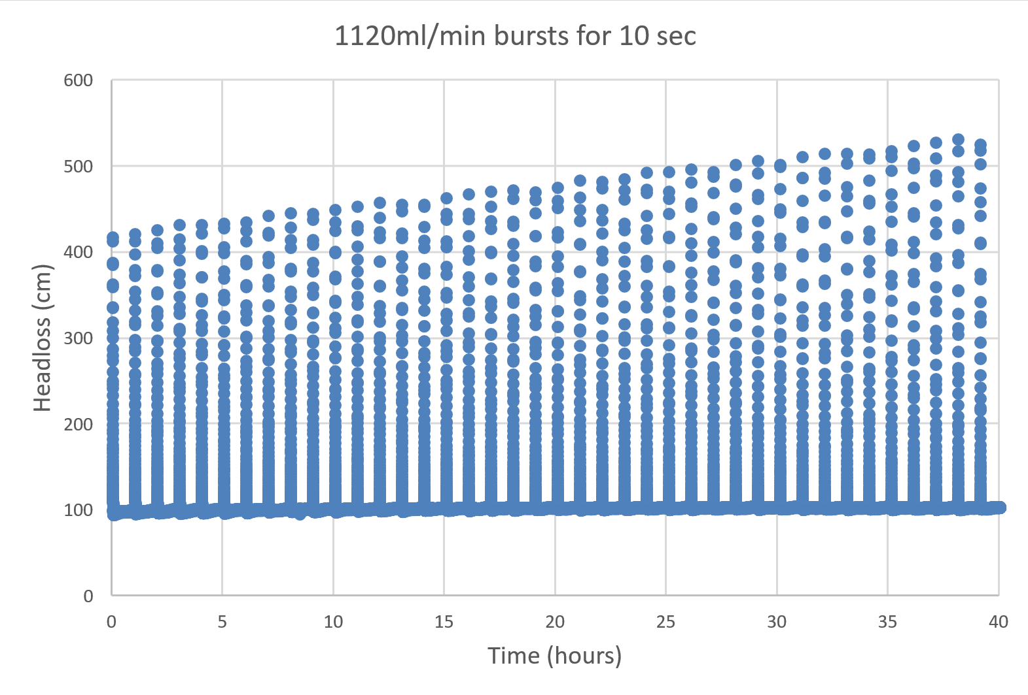
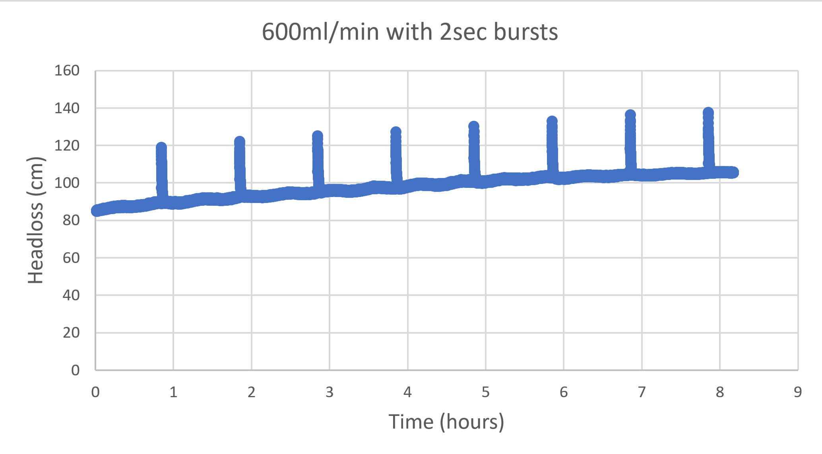
Pressure can be negated through increased flow from the influent pump
High G Flocculation | Research | Symposiums Presentation Spring 2018
Notes:
Figure: Pressure Sensor Data of Syringe Experiment
From figure 16, we see that pushing water through the flocculator at a high speed is indeed capable of clearing out the PACl responsible for increasing the pressure in the flocculator tubing. The pressure drop while filling the syringe and the pressure increase when ejecting the water has been neglected in the image in order to focus on the effect of the burst of water. The high sheer from the increased flow was successful in clearing the built up coagulant and dropping the pressure form 160cm to 80cm.

Slide 9
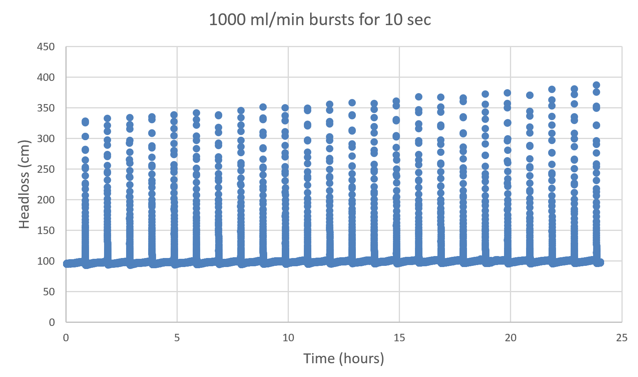
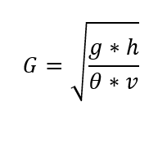
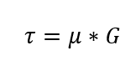
Lowest Shear on Tube Walls Required
1.6 Pascals ~ 1815 Hz
High G Flocculation | Research | Symposiums Presentation Spring 2018
Notes:
Injecting 1000 ml/min 10 sec
We see that the burst of flow was unable to prevent the build up of coagulant in the tubing. Thus, the next experiment will be set to send bursts of 45% (1000ml/min) for 10 second every hour, as it is a value between the successful and unsuccessful trial.

Slide 10
Future Tasks
Test different flocculator tubing sizes. Is an optimal G value consistent with all flocculator sizes?
Work with High Rate Sedimentation to find reason for floc blanket decay and declining removal efficiency as their experiment progresses
Measure the amount of coagulant that sticks to flocculator walls, and understand the physics by which coagulant causes pressure increase in the flocculator. Create mathematical model describing pressure increase
High G Flocculation | Research | Final Presentation Spring 2018

Slide 11
Questions
and
Recommendations
Roswell Lo // rl732@cornell,edl
Mehrin Selimgir // ms3442@cornell.edu
Kanha Matai // km694@cornell.edu
High G Flocculation | Research | Final Presentation Spring 2018

Slide 12
Appendix
Slides
High G Flocculation | Research | Final Presentation Spring 2018
Notes:
From this point on, add any slides with figures that will help support your thesis. You might pull these figures from your Final Report.

Slide 13
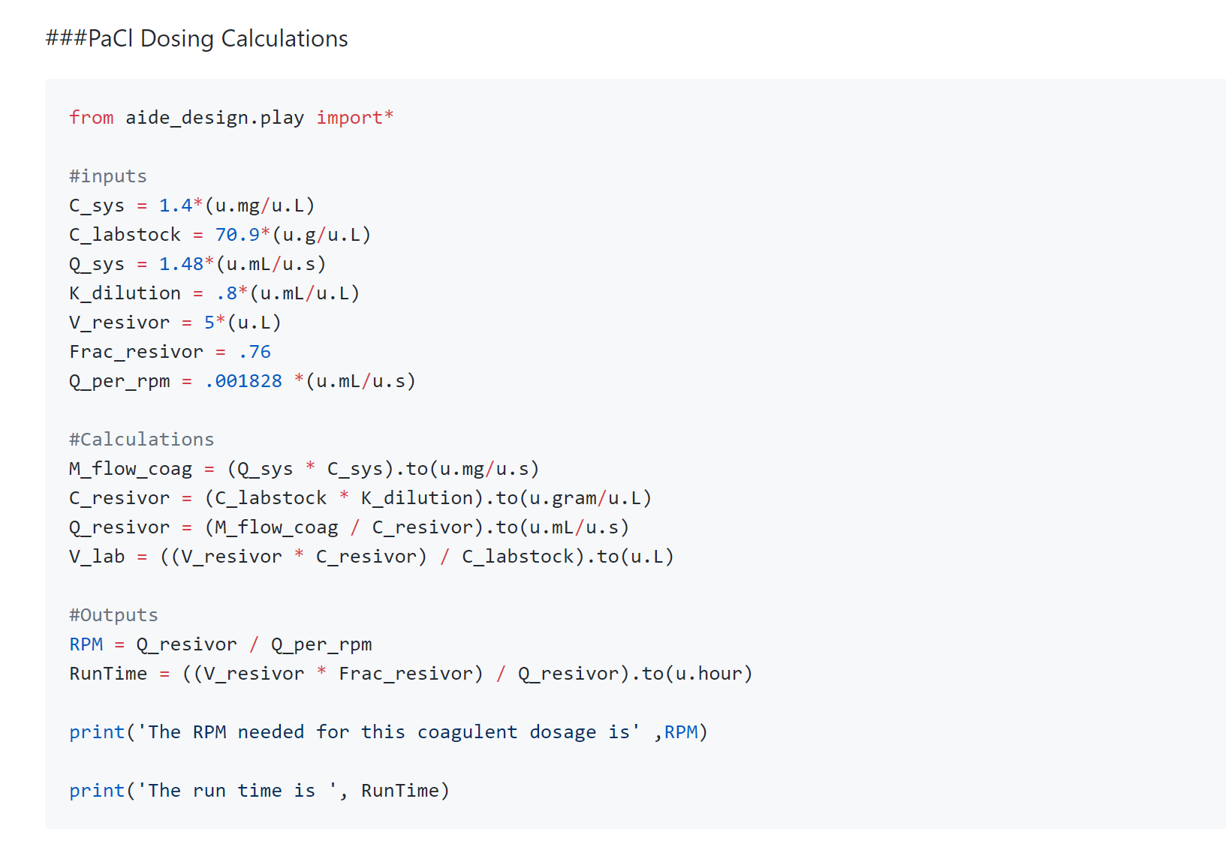
Appendix 1: Python Code
PaCl Dosing Calculations
High G Flocculation | Research | Final Presentation Spring 2018
Notes:
Cite your sources here.
Caption your figure and explain its relevance to your presentation/thesis here. You can take the caption from your Final Report and modify it.
Write a summary of this slide here. A future team member or client should be able to read this note and understand this slide without having your team explain it to them.

Slide 14
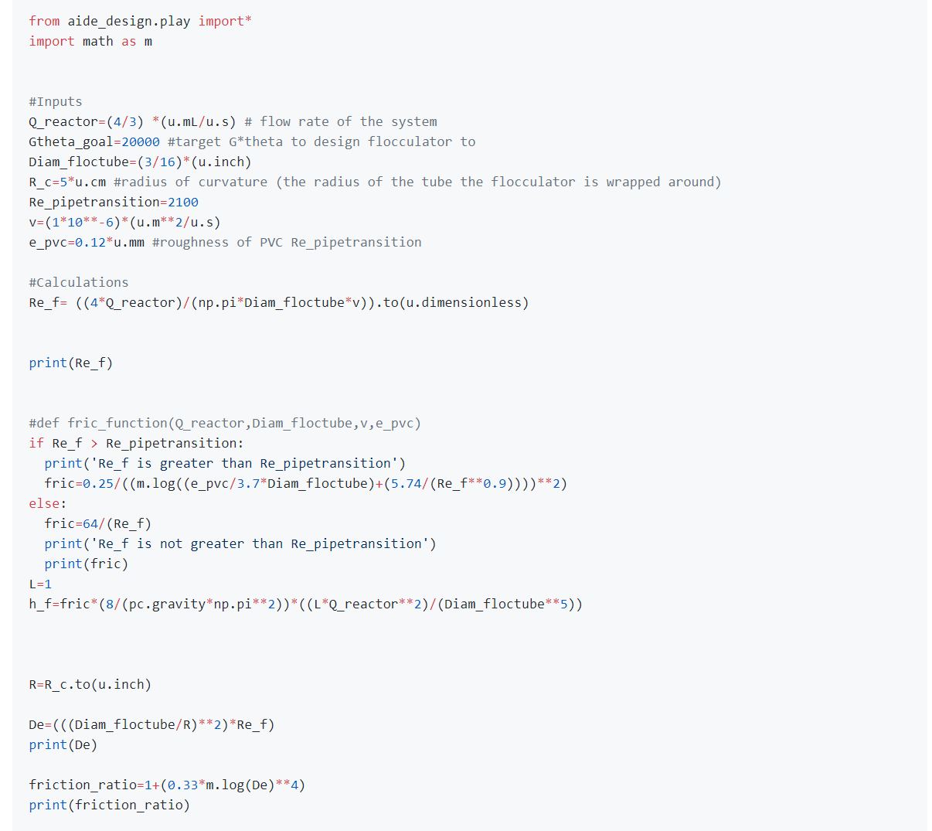
Appendix 2: Python Code
Flocculator Design Calculations
High G Flocculation | Research | Final Presentation Spring 2018
Notes:
Cite your sources here.
Caption your figure and explain its relevance to your presentation/thesis here. You can take the caption from your Final Report and modify it.
Write a summary of this slide here. A future team member or client should be able to read this note and understand this slide without having your team explain it to them.

Slide 15
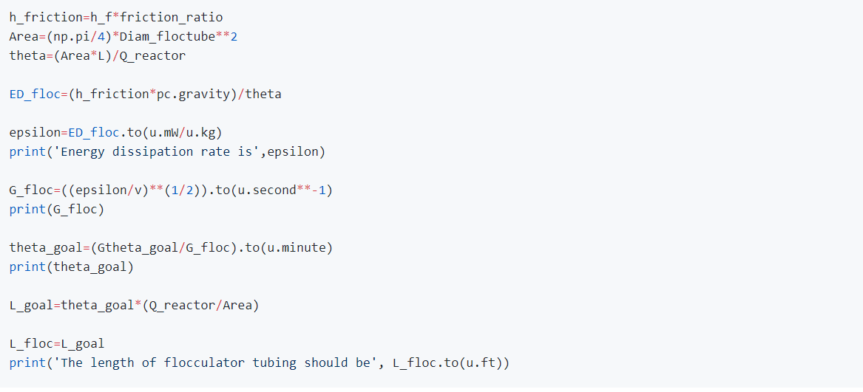
Appendix 2 (Cont.)
Flocculator Design Calculations
High G Flocculation | Research | Final Presentation Spring 2018
Notes:
Cite your sources here.
Caption your figure and explain its relevance to your presentation/thesis here. You can take the caption from your Final Report and modify it.
Write a summary of this slide here. A future team member or client should be able to read this note and understand this slide without having your team explain it to them.

Slide 16
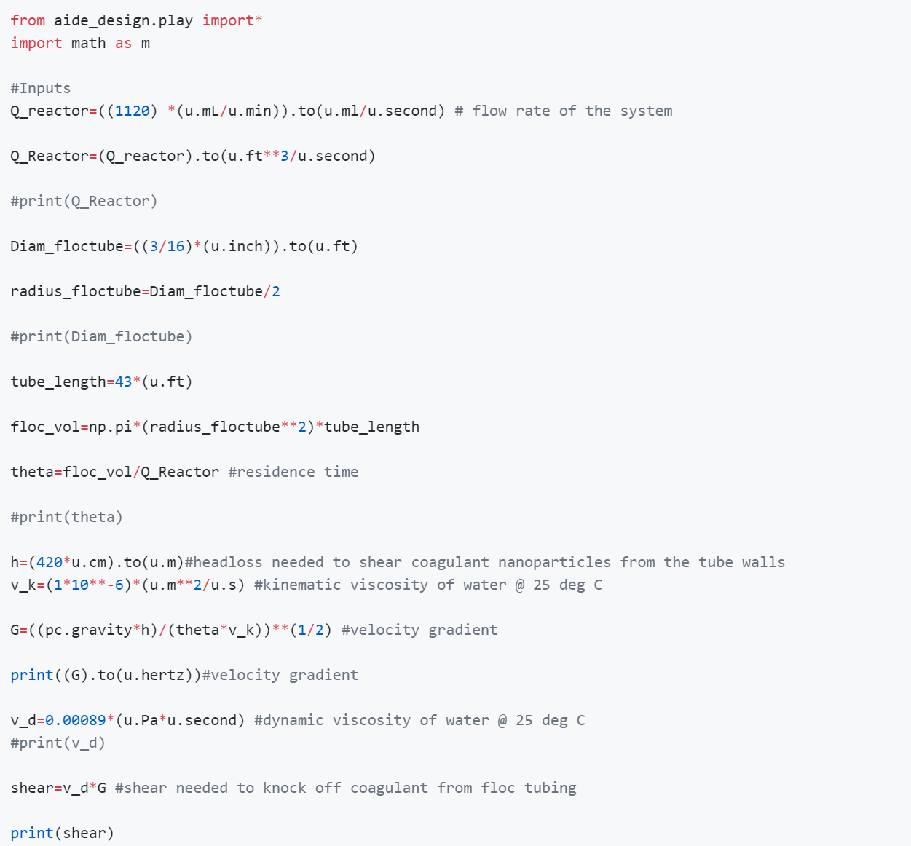
Appendix 3 (Python Code)
Velocity Gradient and Shear Cals
High G Flocculation | Research | Final Presentation Spring 2018
Notes:
Cite your sources here.
Caption your figure and explain its relevance to your presentation/thesis here. You can take the caption from your Final Report and modify it.
Write a summary of this slide here. A future team member or client should be able to read this note and understand this slide without having your team explain it to them.

Slide 17
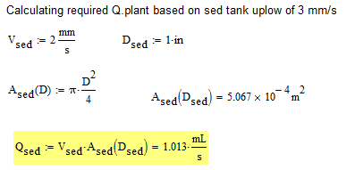
Appendix 3:
The upflow velocity in the tube settler needs to be fixed (2mm/s) to allow formation of a floc blanket
High G Flocculation | Research | Final Presentation Spring 2018
Notes:
Equation Source: Cornell CEE 4540 lecture slides, Flocculator Model.
Calculations for the constant sedimentation tank flow rate based on required velocity for a floc blanket and inner diameter.

